Slide 1
BLG 433E COMPUTER COMMUNICATIONS: SOCKET TUTORIAL
Instructor: Prof. Sema F. OKTUĞ
Teaching Assistant: Müge EREL ÖZÇEVİK
FALL 2017

Slide 2
OUTLINE
Introduction
UNIX I/O paradigm & Network I/O
Motivation
Adding Network I/O to UNIX
What is Socket & Port?
Socket Programming
Stream / Datagram Socket Types

Slide 3
INTRODUCTION UNIX I/O paradigm and Network I/O
UNIX (1960s) timesharing system for single processor computers
User level process
“System calls” between Applications and Operating System
Other procedure calls
Take arguments and return one or more results
(e.g., a buffer to be filled with characters)

Slide 4
INTRODUCTION UNIX I/O paradigm and Network I/O
Open-Read-Write-Close
User process
Open→ to specify the file or device to be used
It returns file descriptor (a small integer)
Read→ transfer data into user process
Write→ transfer data from user process to file or device
Three arguments
(file descriptor, address of buffer, the number of bytes)
Close→ to inform operating system that it has finished

Slide 5
MOTIVATION Adding Network I/O to UNIX
TCP/IP earlier implementation under UNIX used open-read-write-close paradigm with special file name /dev/tcp
Network protocols are more complex than Conventional I/O facilities
Server & Client codes
Traditional UNIX open-read-write-close
Added several new operating system calls as well as new library routines
Notes:
What is the relation of this with Network I/O?
Everthing in UNIX is described as a file.
Therefore, we can read / write over port in order to communicate as reading writing on file.
However, recv and send calls are used instead of them; because of the fact that these processes are more complex.
TCP/IP earlier implementation under UNIX used open-read-write-close paradigm with special file name /dev/tcp. You can check it into your UNIX file system.
However, network protocols are more complex than conventional I/O facilites.
Therefore, server and client definitions are required.
The main is accessing files which are in different hosts with file operations.
To do this, we use traditional UNIX open-read-write-close calls and added several new operating system calls as well as new library routines.

Slide 6
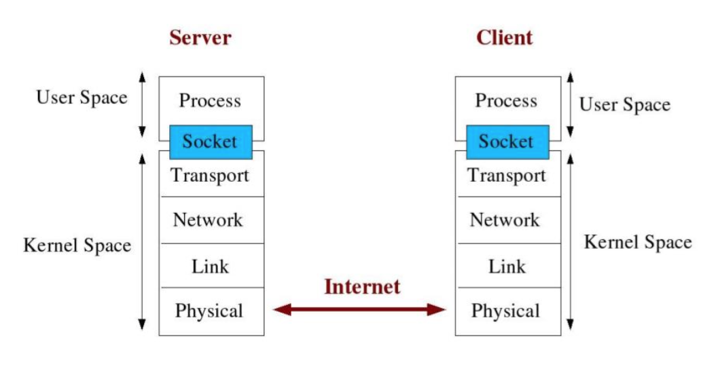
What is Socket & Port?
Socket is interface between Application and Transport layer
The application process can send/receive messages to/from another application process (local or remote)via a socket

Slide 7
What is Socket & Port?
Multi process can be on internet from one computer (same IP address)
There should be different Ports
Internet sockets characterized by IP Address (4 bytes) and port number (2 bytes)
Port number → 0 to 65536
Web sites: HTTP , port # = 80, over TCP
E-mail: POP3, port #=110, over TCP
Notes:
You can think as Port is the door of process, that enable to get out. Multi process can be on internet from one computer (they have same IP adress). Therefore, we should have different. Therefore, Socket is defined as IP + port number. Internet sockets characterized by 4 bytes IP addresses and 2 bytes port number. The initial 1024 are used for special things. Therefore, you can use remaining part. For example, HTTP process listen 80 port over TCP and POP3 run over TCP with port number 110.

Slide 8
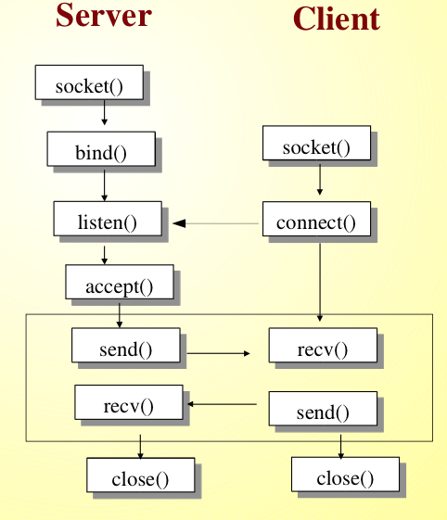
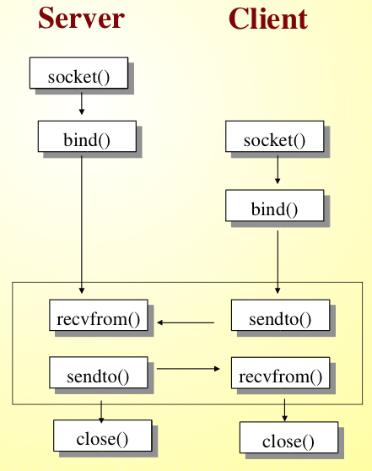
Socket Programming Internet Socket Types
Stream Socket (SOCK_STREAM)
Connection Oriented-Over TCP
Datagram Socket (SOCK_DGRAM)
Connectionless-Over UDP

Slide 9
Socket Programming
socket() → Get the file descriptor
bind() - what port am I on?
connect() - Hello!
listen() - Call me please!
accept() - Thank you for calling !
send() and recv() - Let's talk!
sendto() and recvfrom()-DGRAM style
close()→bye bye!

Slide 10
Questions
R6. Suppose you wanted to do a transaction from a remote client to a server as fast as possible. Would you use UDP or TCP? Why?

Slide 11
Questions
R26. InSection2.7, the UDP server described needed only one socket, where as the TCP server needed two sockets. Why? If the TCP server were to support n simultaneous connections, each from a different client host, how many sockets would the TCP server need?

Slide 12
Questions
R27. For the client-server application over TCP described in Section 2.7, why must the server program be executed before the client program? For the client- server application over UDP, why may the client program be executed before the server program?

Slide 13
Questions
P31. Install and compile the Python programs TCPClient and UDPClient on one host and TCPServer and UDPServer on another host.
Suppose you run TCP Client before you run TCP Server. What happens? Why?
Suppose you run UDP Client before you run UDP Server. What happens? Why?
What happens if you use different port numbers for the client and server sides?

